Slide 1


Web Technology
-By Shivangi Mehta

Slide 2


What will you study?
Introduction to WWW : Protocols and programs
Secure connections
Web servers
Web site design principles, planning the site and navigation

Slide 3

Introduction to WWW
Hypertext makes it easy to link content on one web page to content on another web page or site. Hypertext and HTTP enable people to access the millions of websites active on the WWW.

Slide 4
Web 1.0, 2.0 and Web 3.0 ?
Web 1.0: Defined in 1989. Had no video content and a page format similar to that of a printed page. It focused on providing information.
Around the beginning of the 21st century, Web 2.0 initiated in a new era that was more interactive and dynamic than its predecessor and focused on user collaboration, universal network connectivity and communications channels.
As smartphones, mobile internet access and social networks spurred the growth of Web 2.0, applications -- such as Airbnb, TikTok, Twitter and Uber -- which increased online interactivity and utility, became increasingly popular.

Slide 5
Powered by protocols
A web browser loads a webpage using various protocols:
It uses the Domain Name System (DNS) protocol to convert a domain name into an IP address.
It uses the HyperText Transfer Protocol (HTTP) to request the webpage contents from that IP address.
It may also use the Transport Layer Security (TLS) protocol to serve the website over a secure, encrypted connection.
The web browser uses these protocols on top of the Internet protocols, so every HTTP request also uses TCP and IP.
The Web is just one of the applications built on top of the Internet protocols, but it is by far the most popular.

Slide 6
Secure Connection
Secure connection refers to a connection that uses encryption protocols to protect the data being transferred. A secure connection protects data from unauthorized parties, identifies and authenticates the recipient of the data, and ensures the data has not been tampered with.
SSL (Secure Socket Layer). SSL and its successor, TLS (Transport Layer Security) are cryptographic protocols that protect the communication over the internet.
VPN (virtual private network). A VPN encrypts a user’s connection to the internet and routes it via one of their servers. VPNs can use different protocols, such as OpenVPN or NordLynx, to make the connection secure.
SSH (Secure Shell). SSH is used by administrators and developers to secure a connection between two or more network devices. It is often used to connect to remote devices securely.

Slide 7
IPSec (Internet Protocol Security). IPSec is a set of protocols used to secure communication over the internet. It’s valued for providing confidentiality, integrity, and data authenticity.
SFTP (Secure File Transfer Protocol). SFTP is a secure version of its predecessor, FTP. It is used to transfer sensitive files over the internet.
HTTPS (Hypertext Transfer Protocol Secure). HTTPS provides encrypted communication between the web servers and the client, or, in other words, protects your connection to websites you visit. You can know your connection is secure by the padlock next to the website’s address.

Slide 8
Working of Web
The browser goes to the DNS server, and finds the real address of the server that the website lives on (you find the address of the shop).
The browser sends an HTTP request message to the server, asking it to send a copy of the website to the client (you go to the shop and order your goods). This message, and all other data sent between the client and the server, is sent across your internet connection using TCP/IP.
If the server approves the client's request, the server sends the client a "200 OK" message, which means "Of course you can look at that website! Here it is", and then starts sending the website's files to the browser as a series of small chunks called data packets (the shop gives you your goods, and you bring them back to your house).
The browser assembles the small chunks into a complete web page and displays it to you

Slide 9
What is a web server?
On the hardware side, a web server is a computer that stores web server software and a website's component files (for example, HTML documents, images, CSS stylesheets, and JavaScript files). A web server connects to the Internet and supports physical data interchange with other devices connected to the web.
On the software side, a web server includes several parts that control how web users access hosted files. At a minimum, this is an HTTP server. An HTTP server is software that understands URLs (web addresses) and HTTP (the protocol your browser uses to view webpages). An HTTP server can be accessed through the domain names of the websites it stores, and it delivers the content of these hosted websites to the end user's device.

Slide 10
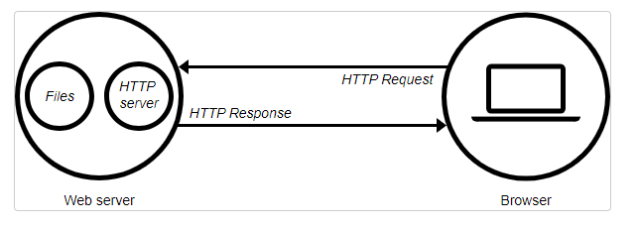
At the most basic level, whenever a browser needs a file that is hosted on a web server, the browser requests the file via HTTP. When the request reaches the correct (hardware) web server, the (software) HTTP server accepts the request, finds the requested document, and sends it back to the browser, also through HTTP. (If the server doesn't find the requested document, it returns a 404 response instead.)

Slide 11
Website Design Principles
Simplicity
Consistency
Color Palette
Responsive
Typography
Fast Loading
User friendly and Easy Navigation

